Slide 1
Chapter 0
Welcome to Intelligent Systems

Slide 2
Course Scope – ITCS 440
This course covers:
✅ Problem Solving Methods
🔍 Search Algorithms & Heuristics
♟️ Game Playing & Strategy
🧠 Knowledge Representation
🧑‍⚕️ Expert Systems
🌫️ Fuzzy Logic & Approximate Reasoning
📊 Machine Learning Techniques

Slide 3
What Will You Learn?
Understand the principles of intelligent systems
Model and solve complex problems using AI methods
Apply search techniques (uninformed, heuristic, adversarial)
Design and implement knowledge-based systems
Explore and apply fuzzy logic and approximate reasoning

Slide 4



Why Study Intelligent Systems?
→ what makes AI worth learning?
DeepSeek ChatGpt DeepMind

Slide 5
AI

Slide 6
Scope of AI
- Game playing
- Theorem proving
- Perception (Vision, speech)
- Natural language processing (LLMs): ChatGPT, DeepSeek
- Expert systems
- Image Processing
- Machine learning
- Intelligent agents
- Pattern Recognition
- Robotics

Slide 7
Why Study Intelligent Systems?
AI is transforming industries: healthcare, finance, transportation
Huge demand for AI skills in the job market
It's the future of computing

Slide 8
History of Intelligent Systems
1950: Turing Test (Tests machine intelligence by humans)
1960s: Expert Systems
1980s–90s: Neural Networks & Rule-Based Systems
2010s+: Deep Learning, Autonomous Systems

Slide 9

What is Intelligence?
Intelligence: The ability to perceive, learn, understand, reason, and act to achieve goals.

Slide 10
Solve new problems
Learn from experience
Make good decisions
Adapt to changing environments

Slide 11
What is Intelligent Systems?
A computer system that uses techniques derived from artificial intelligence.
A machine or software that can simulate intelligent behavior.
An intelligent system is an advanced computer system that can gather, analyze and respond to the data it collects from its surrounding environment. It can work and communicate with other agents, such as users or other computer systems. It can also learn from experience and adapt according to current data.

Slide 12
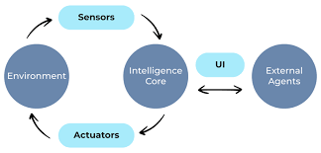
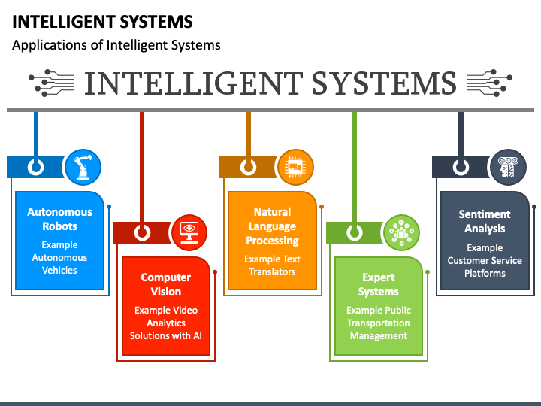
What is Intelligent Systems?

Slide 13
What is an Intelligent System?
It can:
Sense the environment
Learn and make decisions
Solve complex tasks
Interact with humans

Slide 14
What is an Intelligent System?
Examples:
Self-driving cars
Chatbots
Recommendation systems
Industrial robots

Slide 15
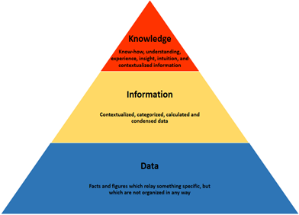
What is an Intelligent System?
Intelligence needs Knowledge
Knowledge in General: Information and skills acquired through experience or education; the theoretical or practical understanding of a subject.
Knowledge is how you map the world (your perception).
Knowledge helps in taking decisions.

Slide 16
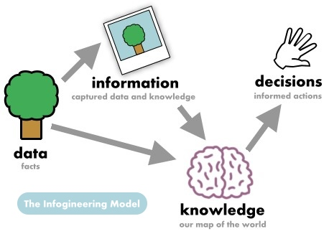
What is an Intelligent System?

Slide 17
What is AI Technique
It is a method that exploits and use the knowledge efficiently. AI techniques are models made from advanced forms of a statistical and mathematical model.
some of the most prominent AI techniques:
Machine Learning (ML)
Natural Language Processing (NLP)
Computer Vision
Deep Learning

Slide 18
AI Technique Example
Pattern recognition problems :
Hash Table Technique
INPUT : Matrix of 0s and 1’s representing the character
1. Hash table technique.
A hash table with an entry for each known letter.
The key for each letter is computed as follows:
Take three rows from the matrix, one one-quarter of the way down, the one in the middle, and one three-quarters of the way down.
Concatenate the rows together to form a key.
No two letters have the same key. If they do, modify the key creation function so that it uses different rows.

Slide 19
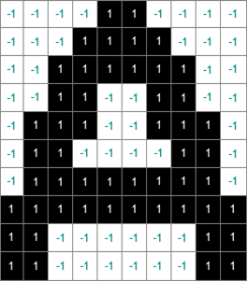
Pattern recognition problems :

Slide 20
Pattern recognition problems
Line 2 + line 5 + line 9
0 0 0 1 1 1 1 0 0 0 0 1 1 1 0 0 1 1 1 0 1 1 0 0 0 0 0 0 1 1
Row x (# of positions of 1s x 2 + # of positions of 0s x 1) + …..
1x(4x2+6x1) + 2 x(6x2+4x1)+ 3 x (4x2+7x1)
1 x (14) + 2 x (16) + 3 x (15)
14 + 32+ 45 = 91
If the hash table size is 26 slots, the key is
91mod 26 = 13

Slide 21
Pattern recognition problems
The Algorithm (To look for a certain character)
+ Take the bits of the input matrix that come from the same three rows uses to construct the table of patterns and use them to form a key.
+ To find a certain character compute its key with the same method explained before and find its corresponding character in the table.

Slide 22
Pattern recognition problems Hash Table Technique
Disadvantage :
input letters must match the stored pattern exactly (not allowed to be thicker or thinner),
DB need to be changed if new letters are added, if no. of symbols become very large,
it is not easy to have single key for each pattern

Slide 23
Pattern recognition problems VECTOR Technique
A set of vectors each of length pattern. Each vector represents one alphabet. Each of these vectors is computed by taking the bit matrix corresponding to the pattern and divide it into N regions. Then the number of 1’ in each region is counted and recorded in the vector position corresponding to the region. N must be large enough that all the patterns are represented as different vectors.

Slide 24
VECTOR Technique
5 regions
Each region is 2 lines for example, Then the vector for the above alphabet would be
6
10
10
18
8

Slide 25
VECTOR Technique
The algorithm (To look for a certain character)
Convert the matrix to N-dimensional vector as described above, where N is the number of specified regions.
Compute the distance in N-dimensional space of the vector from each of the pre calculated pattern vectors.
Classify the input as matching the pattern to which it is closest.

Slide 26
VECTOR Technique
Disadvantage
It can not easily distinguish between significant and insignificant differences i j sig., i I insig.
different sizes of the same letter can not be recognized.
It can not handle acceptable variations of certain character (e.g., G))

Slide 27
Pattern recognition problems SET OF FEATURES Technique
A set of descriptions of letters. Each represented as a boolean combination of features.
For example, for G
ARC (a,b) and ABOVE (a,b) and linesegment (b,c) and left(c,b) and (nil or (linesegment(b,d) and below(d,b))) and (nil or (linesegment(a,e) and above(e,a)))

Slide 28
Pattern recognition problems SET OF FEATURES Technique
The algorithm
Find instances of arcs and line segments in the bit matrix and construct a list of the components of the input characters.
Compare this description to each of the stored pattern and find the one that matches the best.
Disadvantages
The details of the features must be very specific (example of letter G and its reverse shape)

Slide 29
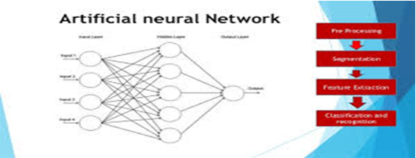
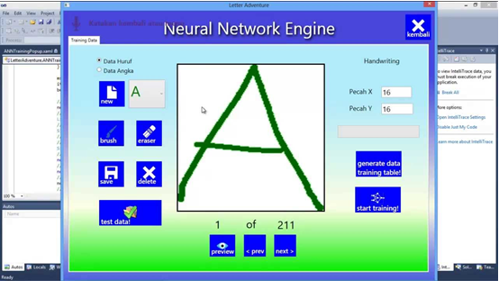
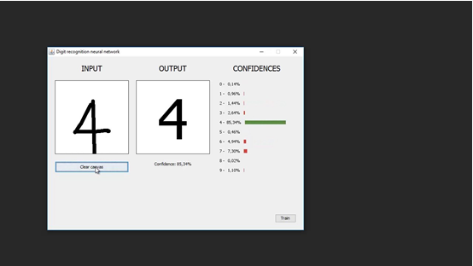
Pattern recognition problems Neural Networks Technique

Slide 30
Pattern recognition problems Neural Networks Technique
https://mco-mnist-draw-rwpxka3zaa-ue.a.run.app/?utm_source=chatgpt.com
https://zbendefy.github.io/machine.academy/WebApps/NumberRecognize/index.html?utm_source=chatgpt.com
https://mattyhempstead.com/projects/mnist?utm_source=chatgpt.com
Example of the training process
https://mil-tokyo.github.io/sukiyaki2/examples/mnist/

Slide 31

Final Thought
"This isn’t magic. It’s intelligent engineering."

